Slide 1
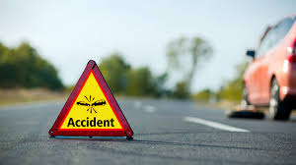
Road Accident Analysis Report (2021–2022)
Pascal Obeng-Poku
Data Analyst
Tools Used (Python [Pandas, Numpy, Matplotlib, Seaborn)

Slide 2
PROJECT OVERVIEW
Objective: Identify patterns, risk factors, and prevention strategies
Focus area: Time trends
Geographic hotspots
Environmental conditions
Driver behaviour
307,973 accidents and 417,883 casualties

Slide 3
EXECUTIVE SUMMARY
307K accidents | 563K vehicles | 417K casualties
~85% are slight severity
Majority occur in urban areas
Peak: evenings, Fridays, Oct–Nov
Implication: Accidents are driven by high exposure, not extreme conditions

Slide 4
GEOGRAPHIC INSIGHT
Top High-Risk Areas
Birmingham
Leeds
Manchester
Bradford
Westminster
Implication: Urban areas = higher traffic density → higher accident risk

Slide 5
TEMPORAL TRENDS
2021: 163,554
2022: 144,419
Peak Months:
November
October
July
Implication: Late-year spikes due to weather + reduced daylight + travel

Slide 6
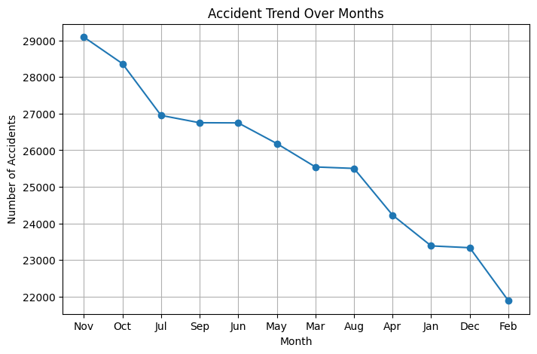

Slide 7
WEEKLY PATTERNS
Friday = highest accidents
Midweek (Tue–Wed) also high
Sunday = lowest
Implication: Fatigue + increased movement drive end-of-week risk

Slide 8
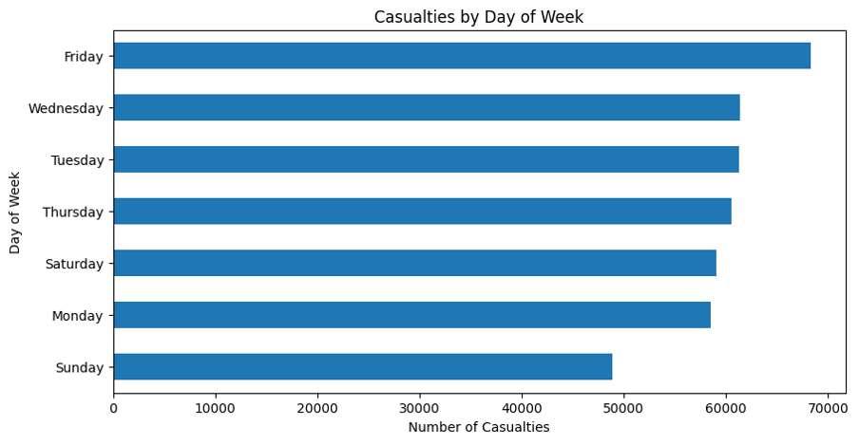

Slide 9
TIME OF DAY ANALYSIS
Peak Hours:
3 PM – 6 PM
Highest at 17:00
Implication: Rush hour = highest congestion + accident probability

Slide 10
VEHICLE INVOLVEMENT
Cars dominate (325K+)
Vans & motorcycles follow
Implication:
Cars → volume-driven risk
Motorcycles → higher relative vulnerability

Slide 11
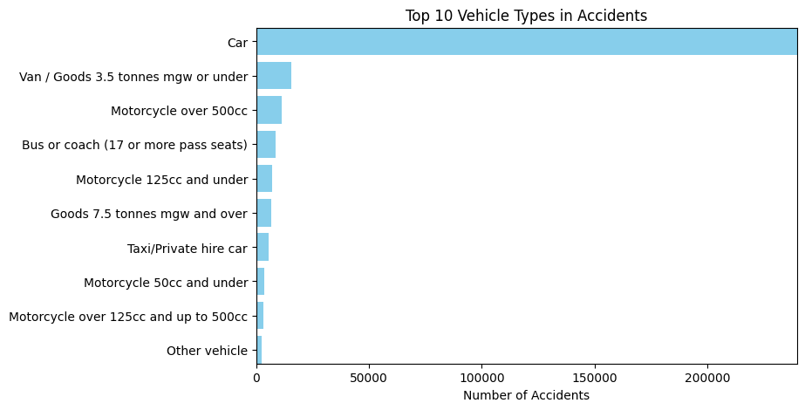

Slide 12
ENVIRONMENTAL CONDITIONS
Weather:
Most accidents in fine weather
Road:
Dry roads dominate
Wet roads → higher severity
Implication: Risk is influenced by behaviour, not just conditions

Slide 13
URBAN VRS RURAL
Urban: 255K
Rural: 162K
Implication: Urban areas = intersections + congestion = higher risk

Slide 14
SPEED ANALYSIS
30 mph zones = highest accidents
Higher speeds = fewer but more severe
Implication: Urban low-speed zones are high-frequency risk areas

Slide 15
ACCIDENT SEVERITY
Slight: ~85%
Serious: 59K
Fatal: 7K
Implication: Most are minor, but fatalities remain preventable

Slide 16
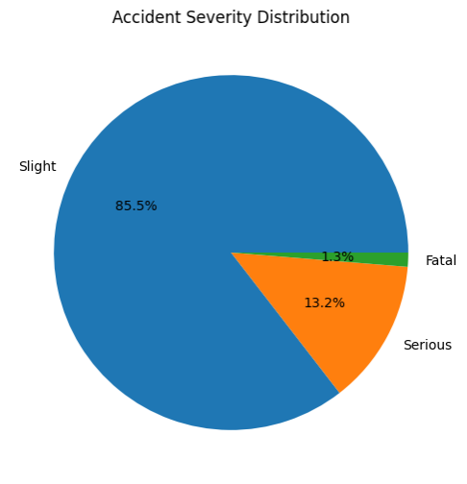

Slide 17
KEY RISK PATTERNS
High-Risk Scenario:
Urban + 30 mph + Car + Daylight + Evening
Key Drivers:
Congestion
Rush hour
Seasonal trends
Human factors (fatigue, distraction)

Slide 18
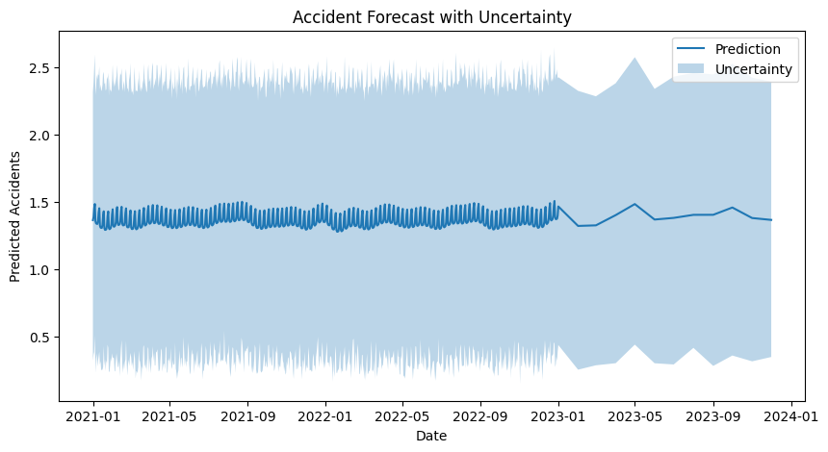
FORECAST

Slide 19
RECOMMENDATIONS
Urban Traffic & Infrastructure
Optimize traffic light timing during rush hours (3–6 PM)
Introduce dedicated turning lanes at high-risk intersections
Deploy real-time traffic monitoring systems in major cities
Improve road markings and signage visibility, especially in busy zones
Driver Behaviour & Enforcement
Increase police presence on Fridays and evening hours
Enforce strict speed monitoring in 30 mph zones (speed cameras)
Launch targeted campaigns on:
Distracted driving (mobile phone use)
Fatigue during end-of-week driving
Introduce penalties for repeat traffic offenders

Slide 20
RECOMMENDATIONS II
Rush Hour Risk Reduction
Encourage flexible work hours / staggered commuting
Promote public transport and carpooling to reduce congestion
Use live traffic alerts via mobile apps to redirect drivers
Weather & Seasonal Preparedness
Issue real-time weather-based driving alerts
Pre-treat roads and improve drainage in rain-prone areas
Increase enforcement and awareness during:
October–November peaks
Holiday travel periods

Slide 21
RECOMMENDATIONS III
High-Risk Road Users (Motorcycles)
Mandatory protective gear enforcement (helmets, reflective wear)
Create dedicated motorcycle lanes where possible
Offer subsidized rider safety training programs
Data & Smart City Solutions
Implement AI-powered accident prediction systems
Use historical data to identify and monitor accident hotspots
Install smart cameras for real-time violation detection
Continuously update policies based on data insights

Slide 22
RECOMMENDATIONS IV
Public Awareness & Education
Introduce road safety education in schools and workplaces
Run localized awareness campaigns in high-risk districts
Use social media for targeted safety messaging during peak periods
Emergency Response Improvement
Improve ambulance response time in urban hotspots
Position emergency units closer to high-accident zones
Use GPS systems to optimize emergency routing

Slide 23
Thank you!!!

